Slide 1
Airline Crew Scheduler
Dylan Kaneshiro, Vaidehi Patil, Hiranmayi Tangella, Hruday Rudraraju, Chandini Muthukumar,
Fiona Burleson, Austin Polk

Slide 2
MOTIVATION
Experiencing flight delays and rescheduling can be frustrating. Imagine the ripple effect at an airport, where one delay triggers a cascade of rescheduled flights, impacting crews, passengers, and logistics. To address these challenges, we developed an Airline Planning software for timely and efficient adjustments to airline plans and recoveries.

Slide 3
OBJECTIVE
Streamlining Airline Operations: Our app focuses on optimizing airline planning and recovery processes.
Efficient Crew Scheduling: Seamlessly connect available crew members to scheduled flights, ensuring optimal resource allocation.
Adaptive Recovery: Our app intelligently adjusts schedules in response to delays or cancellations, minimizing disruptions.
Empowering Crew Members: Crew members can easily access schedules, report unavailabilities, and stay informed through our user-friendly app

Slide 4
HARDWARE
SOFTWARE
COST
ESTIMATION
PERSONNEL
TOTAL
$29,940
$3,399.50
$19,800
$53,139.50

Slide 5
PROJECT TIMELINE
Start date: January 8, 2024
Project Duration: 11 weeks (calculated by FP method)
End date: March 22, 2024
Weekends: Employees will not work on weekends.
Working hours per day dedicated to the project: 6 out of the 8 work hrs/day
Schedule: Our development team of 20 will be divided into 4 groups that will handle: Constructing the data model, constructing data transformation algorithms, constructing UI, and constructing the Controller. The schedule will be broken down into 2 week sprints.

Slide 6
PROJECT TIMELINE
-Create and test secure login table and simple transformations (Create, Read, Update, Delete, while maintaining functional constraints)
-Begin researching flight scheduling algorithm (column generation algorithm for one flight + batch of flights)
-Create login page
-Create login controller
-Create flights table
-Continue
-Create pilot / flight attendant view
-Create view schedule controller
-Create and test crew schedule table
-Begin implementation
-Continue pilot / flight attendant view
-Create insert / edit availabilities controller
-Create and test crew availability table (+ query function to union schedule and availabilities)
-Continue implementation
-Create system admin view
-Create recalculate flights controller
-Integrate functionality
-Finalize Implementation
-Integrate functionality
-Create system admin controller
Project Complete!
1/22
1/22
2/5
2/19
3/11
3/22

Slide 7
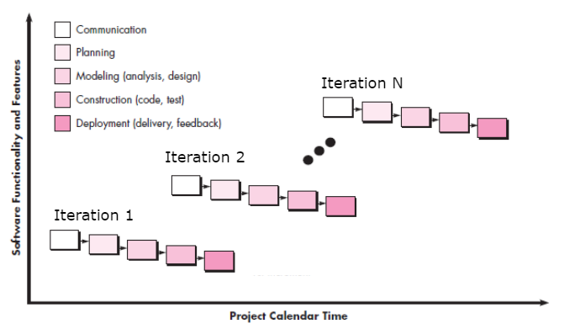
SOFTWARE PROCESS MODEL
This project will employ the iterative software process model. This will help the team to effectively manage risk and deal with requirements that may be subject to change as the project grows in scope.
This also allows the project to be divided up into smaller portions and allows client feedback to be gathered to improve upon features already in the design and keep track of new features desired by the client(s)

Slide 8
FUNCTIONAL REQUIREMENTS
Mobile application for flight crew to report schedule or airplane issues
Database storing available planes and crew with quick read and write times
Algorithm that dynamically reassigns planes and crew based on any issues that occur
APIs to receive information about issues with planes and flight crew
APIs that update available plane and crew from changes to flight arrival times
APIs alerting flight crew of updates to their schedules from the original schedule

Slide 9
NON-FUNCTIONAL REQUIREMENTS
Product requirements
Organizational requirements
External requirements
Should be able to keep each crews schedule private and out of the view of other people unless another crew member shares the same flight, then it will only show the crew's schedule of that particular flight to the other crew members
The system will be used only by the crew of each airline and the members who will push changes. The crew members can also report on the system if they are unable to work on the flight in case of emergencies.
.
The software must follow rules from 14 CFR 91.533 which includes whether a person may operate an airplane or not based on the ratio of passengers to crew members.

Slide 10
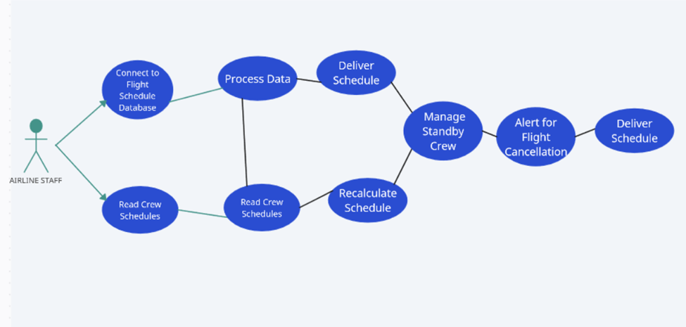
USE CASE DIAGRAM

Slide 11
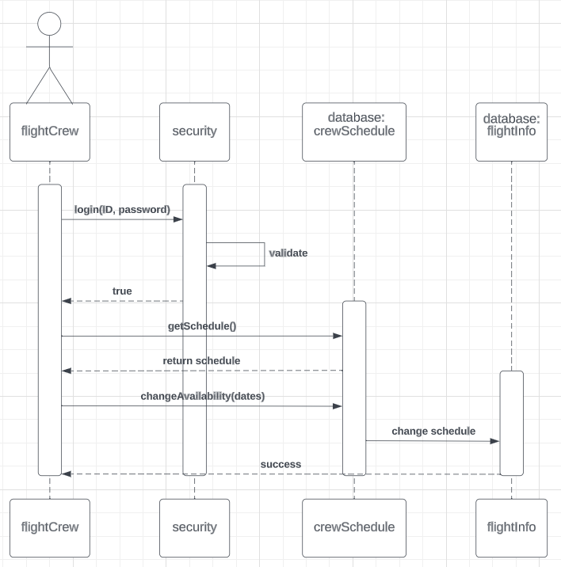
SEQUENCE
DIAGRAM

Slide 12
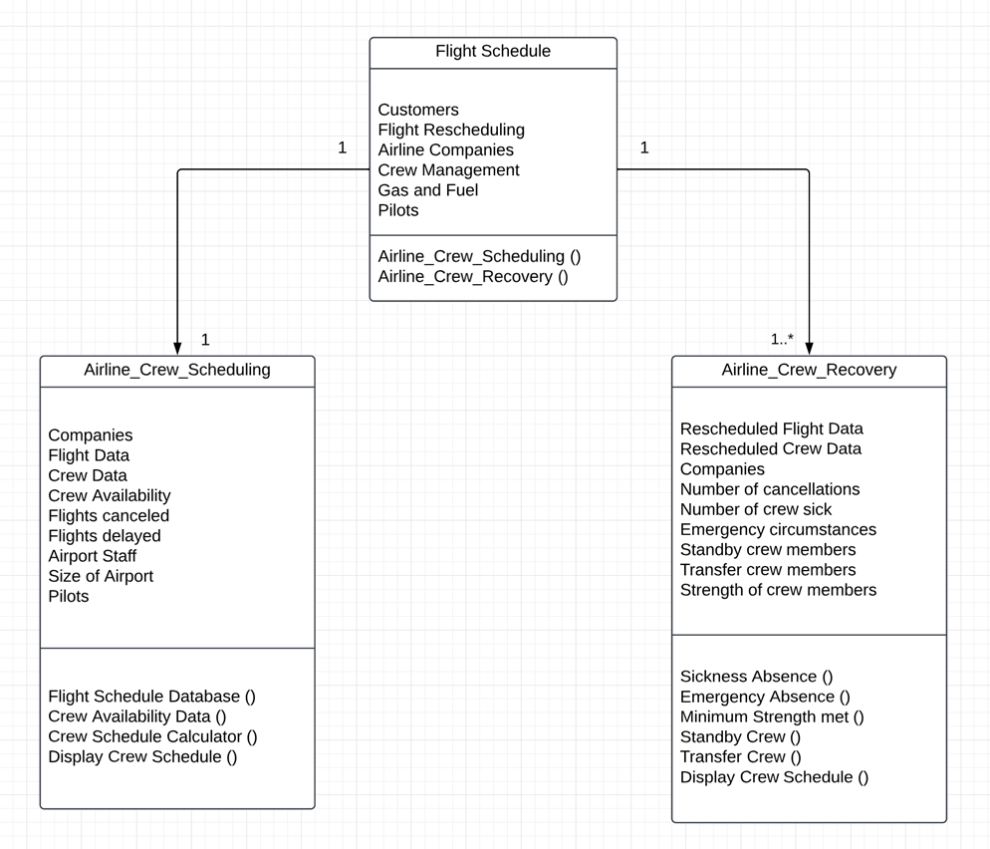
CLASS DIAGRAM

Slide 13

MODEL-VIEW-CONTROLLER (MVC) PATTERN
OVERVIEW
Our app will not just be downloaded by companies. Ideally, companies would consult with us and we would build an app that is tailored to their specific business needs and constraints, in a way similar to Oracle applications. The foundation of the app is described in the next few slides in terms of the MVC architecture.

Slide 14
MODEL CLASS - DATA STRUCTURE
Data Tables:
User Login
Columns: EmployeeID, Name, Password, Job (Pilot, Flight Attendant, or System Admin)
Flights
Columns: Flight Number, Airplane Identifier, Departure Airport, Departure Gate, Departure Time, Arrival Airport, Arrival Gate, Arrival Time
Populated by a process outside the app, pulling data from the client's database
Crew Availability
Columns: Unavailability Start, Unavailability End
Crew Schedule
Columns: EmployeeID, Flight Number

Slide 15
MODEL CLASS - OPERATIONS AND FUNCTIONS
Data Transformations:
Schedule Crew for Flight
Input: Flight Number, Flights database, Crew Availability, Crew Schedule
Output: Modified Crew Schedule
Schedule Crew for Flights
Input: Flight Numbers, Flights database, Crew Availability, Crew Schedule
Output: Modified Crew Schedule
Algorithm: Column Generation
Paper:https://www.researchgate.net/profile/Chen-Shijun/publication/237074620_An_Improved_Column_Generation_Algorithm_for_Crew_Scheduling_Problems/links/0deec51b3f06611f3c000000/An-Improved-Column-Generation-Algorithm-for-Crew-Scheduling-Problems.pdf
Video:https://www.youtube.com/watch?v=YDqegcUu5Y4

Slide 16
MODEL CLASS - OPERATIONS AND FUNCTIONS (PART 2)
Additional Operations:
Cancel Crew for Canceled Flight
Input: Flight Number, Flights database, Crew Availability, Crew Schedule
Output: Modified Crew Schedule
Edit Crew for Flight
Input: Flight Number, Flights database, Crew Availability, Crew Schedule, Crew member to remove
Output: Modified Crew Schedule
Add/Remove from Crew Schedule and Crew Availability
Input: EmployeeID, Unavailability Start time, Unavailability End time, Crew Schedule, Crew Availability
Output: Modified Crew Schedule
Query functions for all tables
Combine Crew Schedule and Availability into Calendar
Input: EmployeeID, Crew Schedule, Crew Availability
Output: Calendar
Validate Assignment
Ensures crew assignment meets constraints and legal requirements
Input: Employee IDs, Flight Number
Output: True, False
Validate Login
Input: Username, Password
Output: True, False

Slide 17
MODEL CLASS- VIEW CLASS
Dynamically Displayed HTML:
All users login page
If login successful:
User-Specific Views:
Pilot / Flight Attendant View
View schedule as a calendar
Button to add unavailabilities
Button to cancel unavailabilities
System Admin Interface
Interface to manually recalculate flights
Interface to manually add / remove crew members to flights
Interface to add / remove users

Slide 18
MODEL CLASS-
CONTROLLER CLASS
Our Controller Class will act as a medium between our model and view
- When user clicks submit login, validate login from data model and pass to view
- When user requests to view schedule, call calendar function of data model and pass to view
- When user requests to insert / delete availabilities, call functions to insert and delete by value in data model and refresh view
- When system admin calls recalculate flights, run schedule flights function and refresh view
- When system admin calls to edit a table, edit table in data model and refresh view

Slide 19
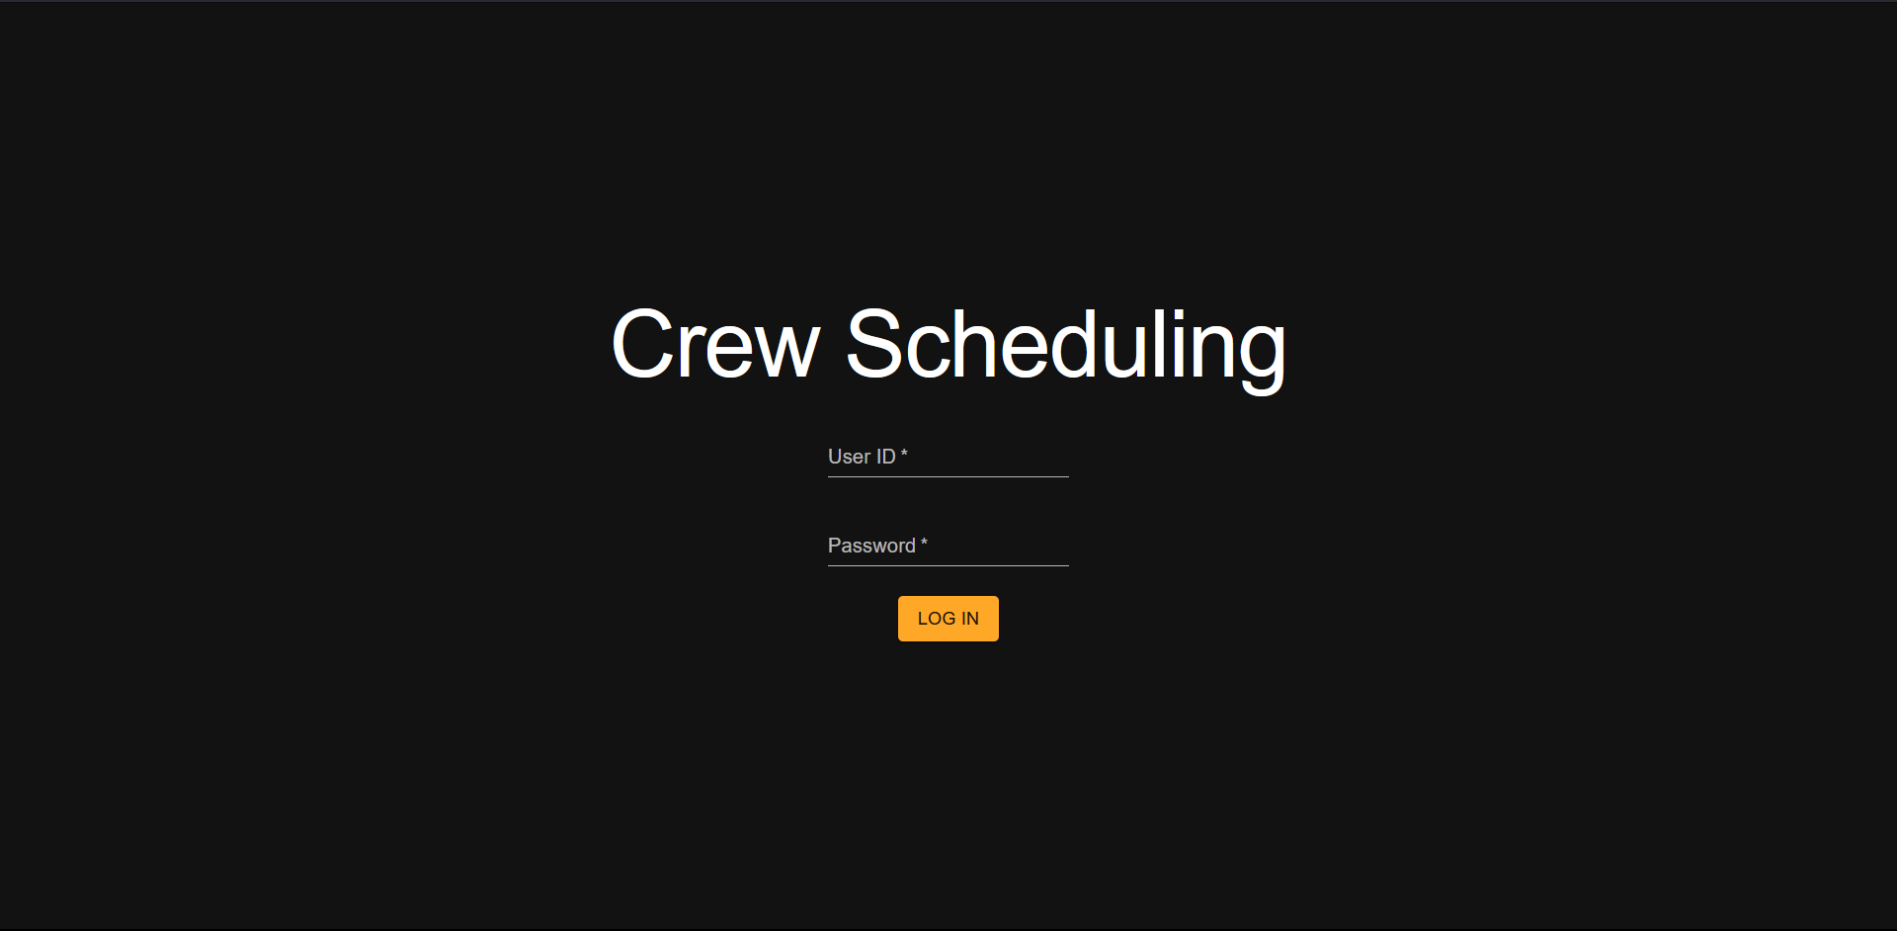

Slide 20
DEMO:
https://mockitt.wondershare.com/proto/vYL6z6m4s4amwuJ64E4alB/sharing?view_mode=device&screen=rbpTvuvr8RSh6W58d&canvasId=rcTnYFbNTvuwEKspjhmcMI

Slide 21
CONCLUSION

Slide 22
[1] C. Barnhart, E. L. Johnson, G. L. Nemhauser, and P. H. Vance, “Crew scheduling,” SpringerLink, https://link.springer.com/chapter/10.1007/978-1-4615-5203-1_14 (accessed Nov. 13, 2023).
[2] “Employee scheduling,” UKG, https://www.ukg.com/solutions/employee-scheduling (accessed Nov. 13, 2023).
[3] “The World’s #1 employee app,” Connecteam, https://connecteam.com/ (accessed Nov. 13, 2023).
REFERENCES

